Slide 1
Ant Maven Gradle
Serhii Kolisnyk

Slide 2

Ant
Ant |ænt| (“Another Neat Tool”) is a Java library used for automating build processes for Java applications. Additionally, Ant can be used for building non-Java applications. It was initially part of Apache Tomcat codebase and was released as a standalone project in 2000.
Serhii Kolisnyk

Slide 3
History
Version | Released Year
1.1 | 19 July 2000
1.2 | 24 October 2000
1.3 | 3 March 2001
1.4 | 3 September 2001
1.4.1 | 11 October 2001
1.5 | 10 July 2002
1.5.1 | 3 October 2002
1.5.2 | 3 March 2003
1.5.3 | 9 April 2003
1.5.4 | 12 August 2003
1.6.0 | 18 December 2003
1.6.1 | 12 February 2004
1.6.2 | 16 July 2004
1.6.3 | 28 April 2005
1.6.4 | 19 May 2005
1.6.5 | 2 June 2005
1.7.0 | 19 December 2006
1.7.1 | 27 June 2008
1.8.0 | 8 February 2010
1.8.4 | 23 May 2012
1.9.0 | 07 March 2013
1.10.3 | 27 Mar 2018
1.10.4 | 22 Jun 2018
Ant Version | Minimum Java Version
1.1 up to 1.5.4 | 1.1
1.6.0 up to 1.6.5 | 1.2
1.7.0 up to 1.7.1 | 1.3
1.8.0 up to 1.8.3 | 1.4
Any 1.9.x release and the git branch 1.9.x | 1.5
Any 1.10.x release and the current git master branch | 1.8
Serhii Kolisnyk

Slide 4
Structure
Ant uses an xml file for its configuration. The default file name is build.xml. Ant builds are based on three blocks: tasks, targets, properties, resources.
A task is a unit of work which should be performed and constitutes of small atomic steps, for example compile source code or create Javadoc. Tasks can be grouped into targets.
A target can be directly invoked via Ant. Targets can specify their dependencies. Ant will automatically execute all dependent targets.
Note! In your build.xml file you can specify the default target. Ant executes this target, if no explicit target is specified.
Serhii Kolisnyk

Slide 5
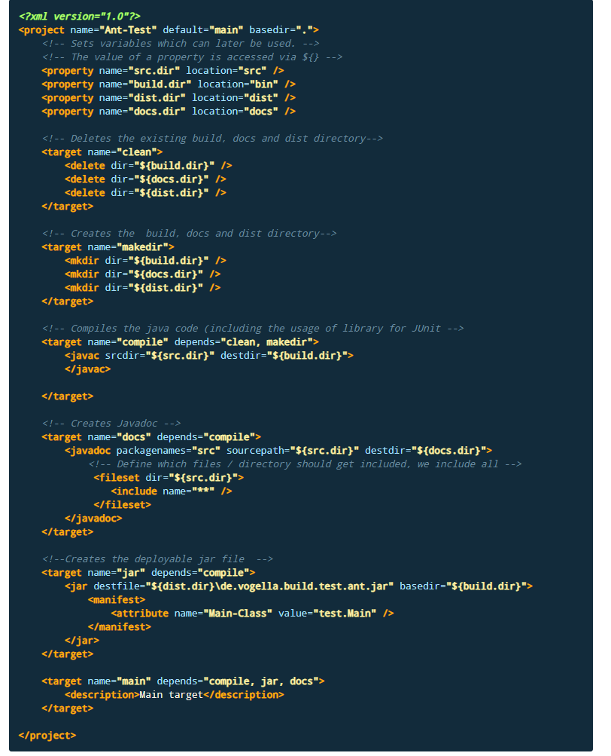
This build file defines targets: clean, makedir, compile, docs, jar, main. For example, we can compile the code by running:
ant compile
Serhii Kolisnyk

Slide 6
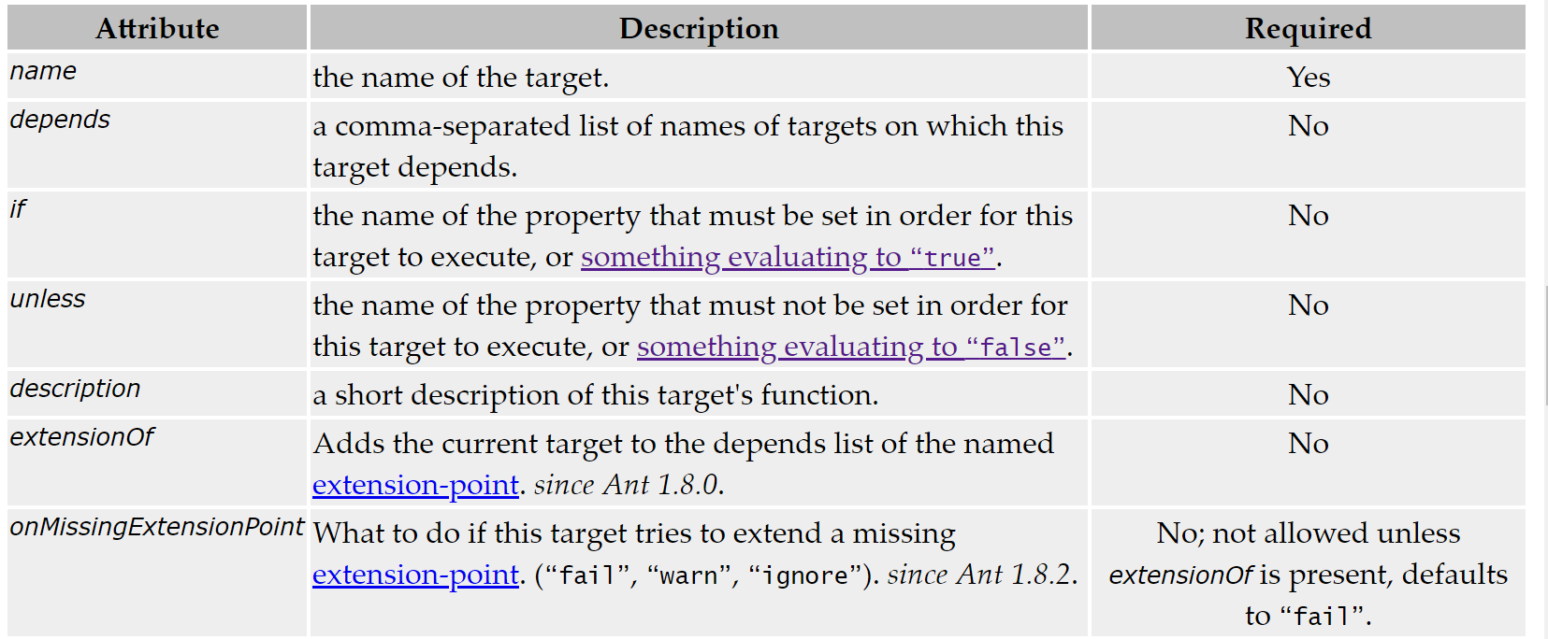
A target attributes
Serhii Kolisnyk

Slide 7
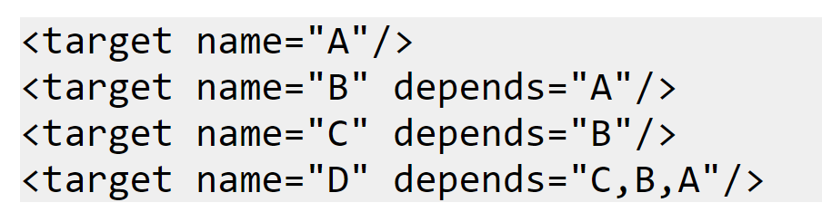
Cases
Ant tries to execute the targets in the depends attribute in the order they appear (from left to right).
Suppose we want to execute target D. From its depends attribute, you might think that first target C, then B and then A is executed. Wrong! C depends on B, and B depends on A, so first A is executed, then B, then C, and finally D.
Call-Graph: A → B → C →
Serhii Kolisnyk

Slide 8
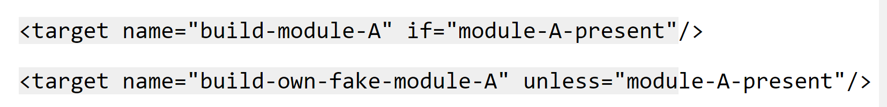
Cases
A target also has the ability to perform its execution if (or unless) a property has been set.
In the first example, if the module-A-present property is set (to any value, e.g. false), the target will be run. In the second example, if the module-A-present property is set (again, to any value), the target will not be run.
Note: Only one property name can be specified in the if/unless attribute.
Serhii Kolisnyk

Slide 9
Pros & Cons
Pros:
* XML base means it works well with automatic tools.
* Solid and extensive documentation..
* Once up and running, Ant gives you nearly full control over how things happen.
Cons:
* XML base means less customization capabilities. * Ant makes you do pretty much everything your self, which can be daunting.
* Build scripts are often very different, which makes understanding other projects difficult. * As an old established tool, the community is fairly dead.
Serhii Kolisnyk

Slide 10

Maven
Maven |ˈmeɪv(ə)n| is a dependency management and a build automation tool, primarily used for Java applications. Maven continues to use XML files just like Ant but in a much more manageable way. The name of the game here is convention over configuration.
Serhii Kolisnyk

Slide 11
History
Maven 1 (2003)
Very Ugly
Used in Stack 1
Maven 2 (2005)
Complete rewrite
Not backwards Compatible
Used in Stack 2.0,2.1,2.2,3.0
Maven 3 (2010)
Same as Maven 2 but more stable
Used in Stack 2.3, 3.1
Serhii Kolisnyk

Slide 12
POM
POM stands for "Project Object Model". It is an XML representation of a Maven project held in a file named pom.xml. When in the presence of Maven folks, speaking of a project is speaking in the philosophical sense, beyond a mere collection of files containing code. A project contains configuration files, as well as the developers involved and the roles they play, the defect tracking system, the organization and licenses, the URL of where the project lives, the project's dependencies, and all of the other little pieces that come into play to give code life. It is a one-stop-shop for all things concerning the project. In fact, in the Maven world, a project need not contain any code at all, merely a pom.xml.
Serhii Kolisnyk

Slide 13
Structure
maven-project/pom.xml – defines dependencies and modules needed during the build lifecycle of a Maven project
maven-project/LICENSE.txt – licensing information of the project
maven-project/README.txt – summary of the project
maven-project/NOTICE.txt – information about third-party libraries used in the project
maven-project/src/main – contains source code and resources that become part of the artifact
maven-project/src/test – holds all the test code and resources
maven-project/src/it – usually reserved for integration tests used by the Maven Failsafe Plugin
maven-project/src/site – site documentation created using the Maven Site Plugin
maven-project/src/assembly – assembly configuration for packaging binaries
Serhii Kolisnyk

Slide 14
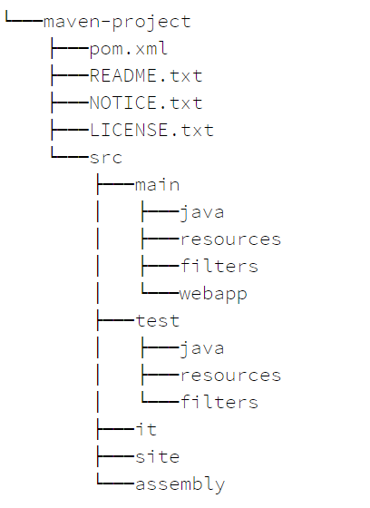
Serhii Kolisnyk

Slide 15
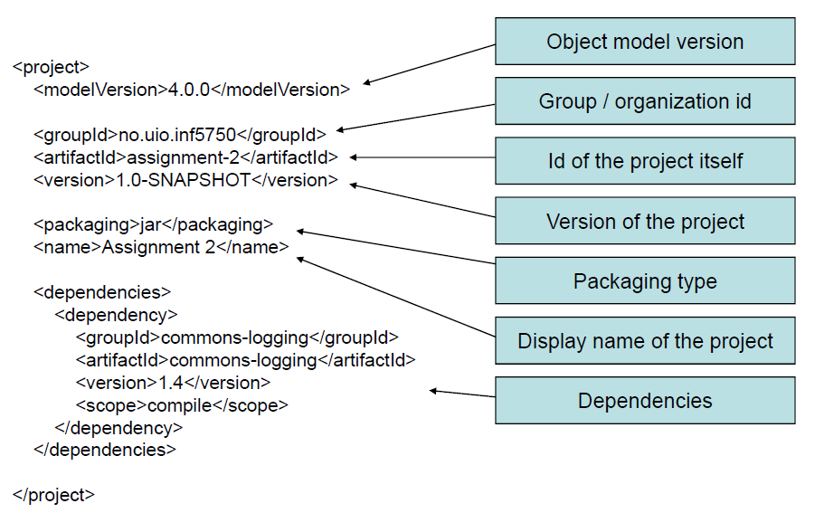
pom.xml
Serhii Kolisnyk

Slide 16
The group ID:
The entity or organization responsible for producing the artifact. For example, com.softserve.edu can be a group ID.
The artifact ID:
The name of the actual artifact. For example, a project with a main class called OpsImp may use OpsImp as its artifact ID.
The version:
A version number of the artifact. The supported format is in the form of mmm.nnn.bbb-qqqqqqq-dd, where mmm is the major version number, nnn is the minor version number, and bbb is the bugfix level. Optionally, either qqqqq (qualifier) or dd (build number) can also be added to the version number.
Serhii Kolisnyk

Slide 17
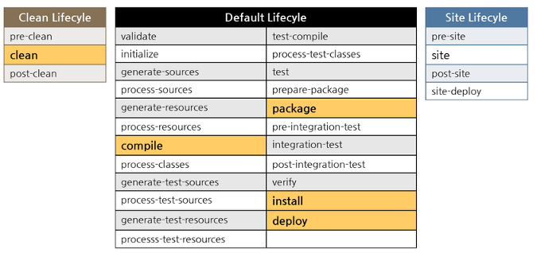
Lifecycle
A Build Lifecycle is a well-defined sequence of phases that outline the order in which the goals are to be executed. Here phase represents a stage in life cycle.
The three build lifecycles are:
•Clean: cleans up artifacts created by previous builds. •Default (or build): this can be accustomed to build the appliance. •Site: generates site documentation for the project.
Serhii Kolisnyk

Slide 18
Phases of a Maven Build Lifecycle
• Validate − validate the project is correct and all necessary information is offered. • Compile − compile the source code of the project. • Test − test the compiled source code employing an appropriate unit testing framework and these tests should not require the code deployed or packaged. • Package − take the compiled code and package it in its distributable format like a JAR (pom, jar, maven-plugin, ejb, war, ear, rar, par). • Integration-test − process and deploy the package if necessary into an n atmosphere wherever integration tests may be run. • Verify − run any tests to verify the package is still valid and meets quality requirements. • Install − Install the package into the native repository, to be used as a dependency in alternative projects regionally. • Deploy − copies the final package to the remote repository for sharing with alternative projects and developers. It is done in an integration or release environment,
Serhii Kolisnyk

Slide 19
Scope
The various dependency scope employed in maven are: •Compile: it’s the default scope, and it indicates what dependency is offered within the classpath of the project •Provided: It indicates that the dependency is provided by JDK or internet server or container at runtime •Runtime: This tells that the dependency isn’t required for compilation, however, is needed throughout the execution •Test: It says dependency is offered just for the take a look at compilation and execution phases •System: It indicates you have got to give the system path •Import: this means that the known or nominative pom ought to get replaced with the dependencies in this POM’s section
Serhii Kolisnyk

Slide 20
Pros & Cons
Pros:
All dependencies are downloaded automatically;
All compile/build/dependency info is bundled with your maven spec
Drastically simplifies the way your build will work/
Turning on new features (such as junit) across the board for things like CI/CD can be as easy as one line in your maven config file.
Cons:
You need to know maven command line or use an ide that has maven integration, such as netbeans or eclispe.
Its verbose and complex.
If you have a dependent jar that isn't mavenized
Serhii Kolisnyk

Slide 21

Gradle
Gradle is a general purpose, declarative build tool. It is general purpose because it can be used to build pretty much anything you care to implement in the build script. It is declarative, since you don't want to see lots of code in the build file, which is not readable and less maintainable. So, while Gradle provides the idea of conventions and a simple and declarative build, it also makes the tool adaptable and developers the ability to extend. It also provides an easy way to customize the default behavior and different hooks to add any third-party features.
Serhii Kolisnyk

Slide 22
Structure
• Gradle build consists of one or more projects
• Project contains one or more tasks
• Task is fundamental unit of build activity
• Tasks are named collections of build instructions
• Tasks are the equivalent to Ant targets
• Task is made up of actions
Serhii Kolisnyk

Slide 23
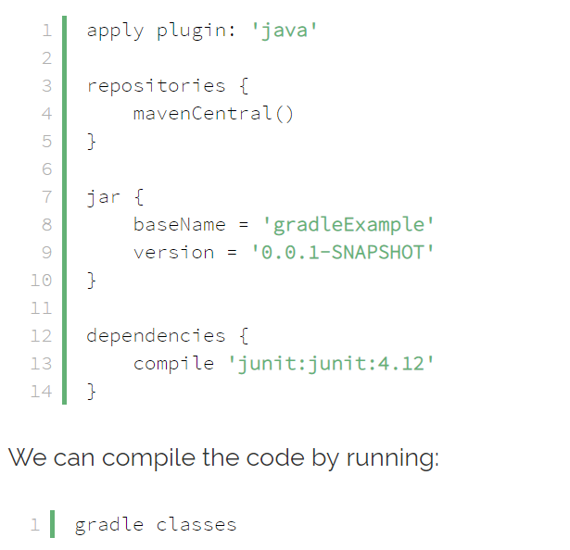
This was adopted by Gradle, which is using a DSL based on Groovy. This led to smaller configuration files with less clutter since the language was specifically designed to solve specific domain problems. Gradle’s configuration file is by convention called build.gradle.
Here is an example of a build.gradle file for the same simple Java project with the HelloWorld main class from before:
Serhii Kolisnyk

Slide 24
Pros & Cons
Pros:
Native Java support
• Ant/Maven integration
• Full IDE support
• Transitive dependency management
• Multiple third-party plugins(70+)
• Incremental builds
• Rapid development
• Performance
Serhii Kolisnyk

Slide 25
Pros & Cons
Cons:
Possible compilation & run-time issues due to script nature
Large learning curve
Less community & industry support
Serhii Kolisnyk

Slide 26
Thank you!
Serhii Kolisnyk

